Slide 1
Neotoma Paleoecology Database: Facilitating transparent data curation in the paleosciences
Jessica Blois
jblois@ucmerced.edu
NSF-Geoinformatics,
NSF-EarthCube
@neotomadb
@jessicablois

Slide 2
Agenda
Introductions
Intro to databases
Intro to Neotoma
Neotoma data model
--- 10:45 – 11:30am: BREAK ---
Neotoma Software Ecosystem
Overview: Getting data into and out of Neotoma
Sandbox time!

Slide 3
Introduction to paleo-databases: motivations and ecosystem
Based on the paper:
Williams J.W., Grimm E.C., Blois J.L., Charles D.F., Davis E.B., Goring S.J., Graham R.W., Smith A.J., Anderson M., Arroyo-Cabrales J., Ashworth A.C., Betancourt J.L., Bills B.W., Booth R.K., Buckland P.I., Curry B.B., Giesecke T., Jackson S.T., Latorre C., Nichols J., Purdum T., Roth R.E., Stryker M., & Takahara H. (2018) The Neotoma Paleoecology Database, a multiproxy, international, community-curated data resource. Quaternary Research, 89, 156–177.
Notes:
Thank you.
Acknowedge collaborators.
Talk in two parts.
First, talk about building community data networks in paleoecology – as example of larger class of activities that I call community curated database
Second, show the kind of large-scale synthetic science that is enabled with open high-quality data platforms, using PalEON as an example.

Slide 4
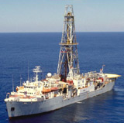
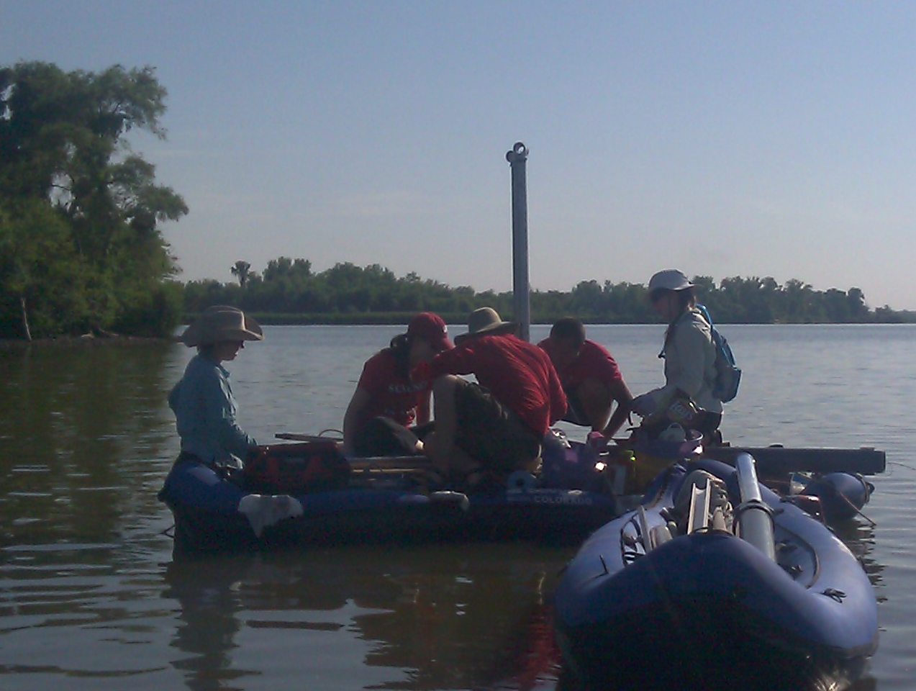
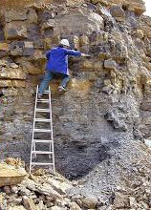
Paleoecological data: Key characteristics
‘Long Tail’: Collected in the field & lab by many individuals and scientific teams.
Heterogeneity: Many kinds of measurements & methods
Distributed Scientific Expertise by proxy type, archive type, region, time period, and/or taxonomic group
Bad News

Slide 5
Paleoecological data: Key characteristics
Commonality: All involve measurements of proxies in various geological archives by depth, from which we estimate time.
Long Shelf Life: specimens & samples collected decades ago are can be re-analyzed
Good News

Slide 6



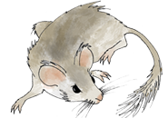
Community-Curated Data Resources
Socio-Technological Characteristics
Shared Mission: gathering, improving, and sharing data
Centered on Communities of Practice
Distributed community governance to encourage data additions, ensure data quality
Centralized IT platform for collecting, refining, and sharing data
Open Data via multiple outlets
Streamlined data uploads for data and metadata
Meso-scale: bridge between long tail and big data
Social
Paleobiology DB
Technological
Neotoma DB
… and others
Notes:
Socio-technological

Slide 8
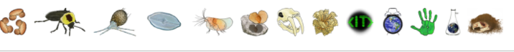
Neotoma Paleoecology Database
Mission: Support global-change research by providing an open, community-curated repository for multiple kinds of paleoecological data
Key Characteristics
Open Data
Curated by Community --> High-Value Data
Standardized Variable Names & Taxonomy
Flexible data models for sites, proxies, cores, etc.
Time: Age Controls and Age Models
>3.8 million observations
>18,900 datasets
>10,000 sites

Slide 9
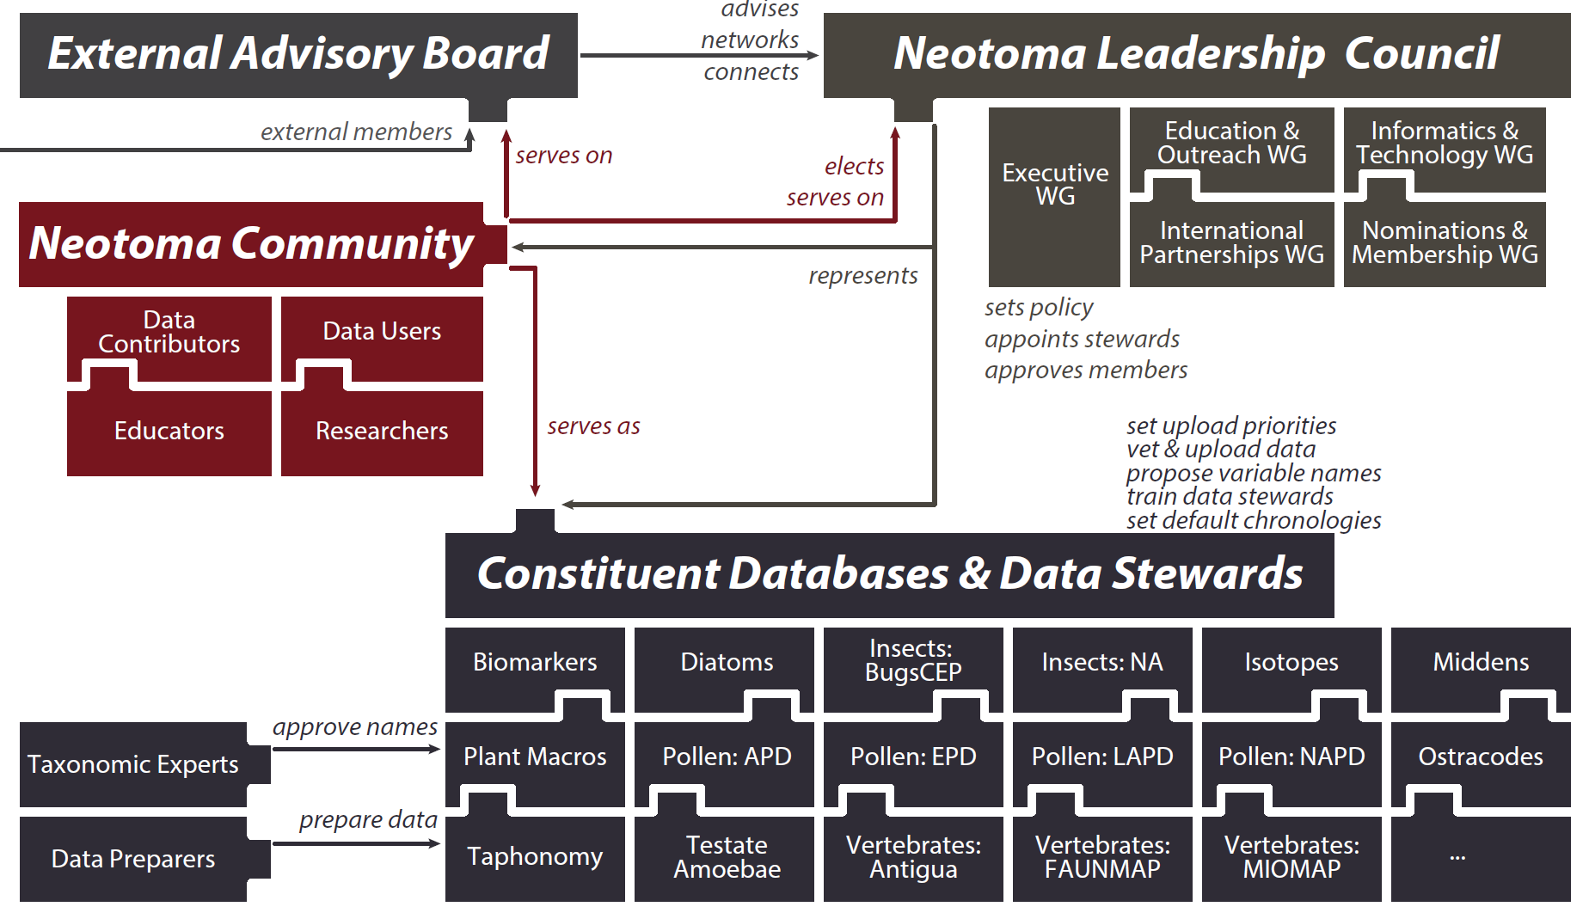
Distributed & Open Scientific Governance

Slide 10
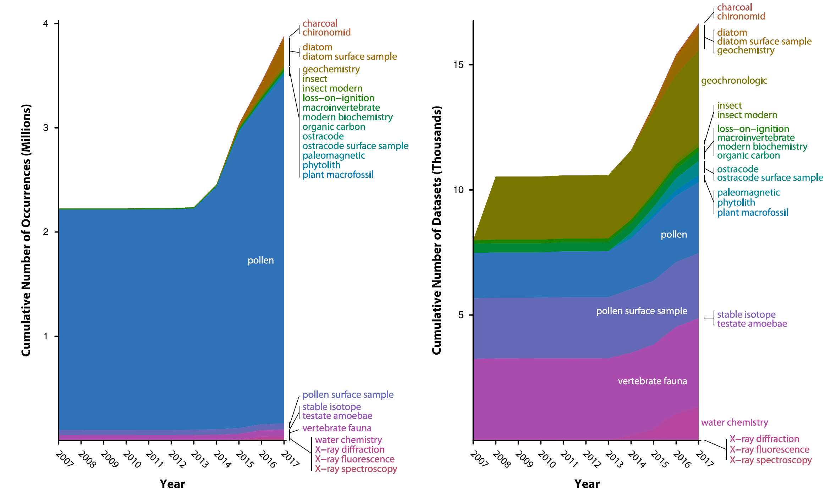
Data Types & Data Volume
2013-2017
# Occurrences
# Datasets

Slide 11
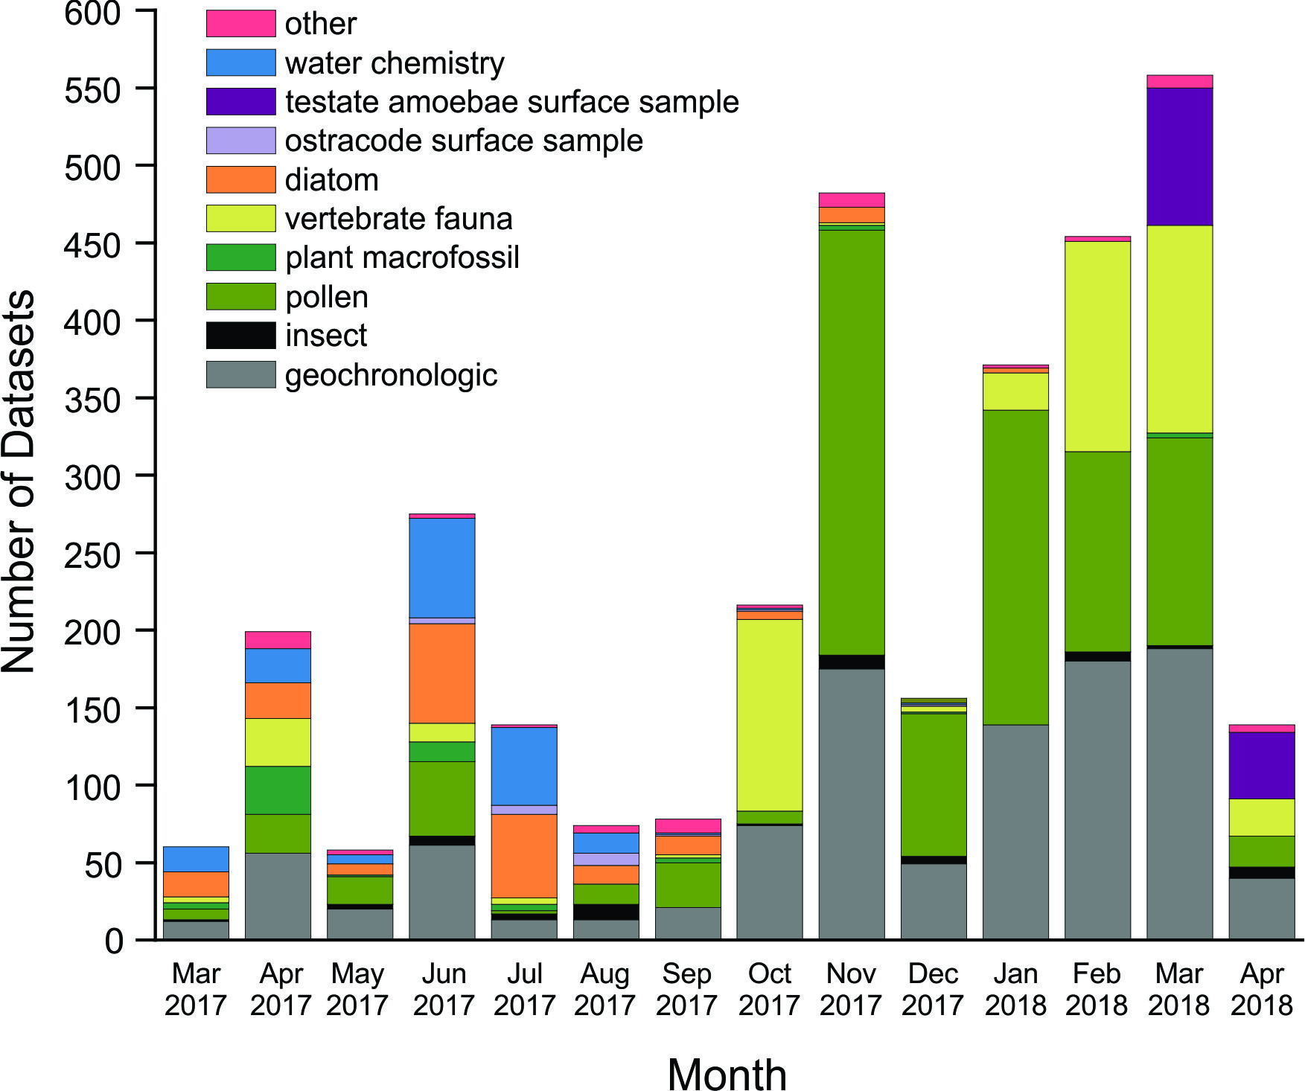
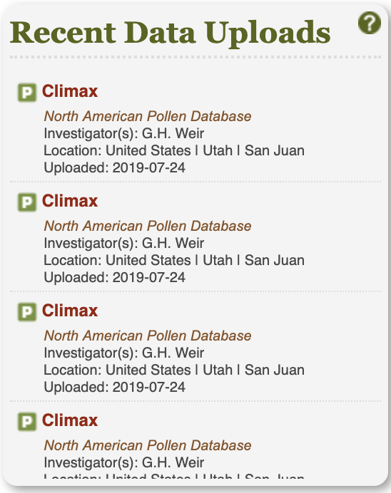
Data Uploads
3/17 – 4/18
July 24, 2019

Slide 12



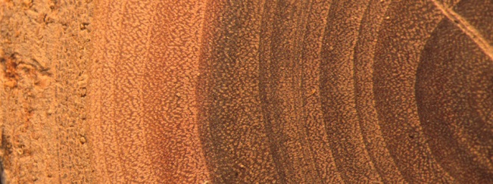


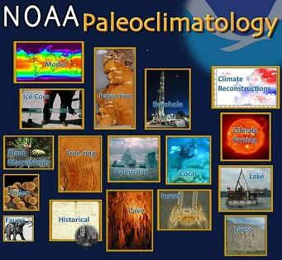
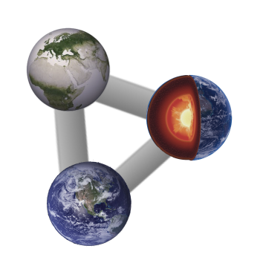




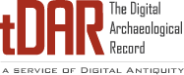


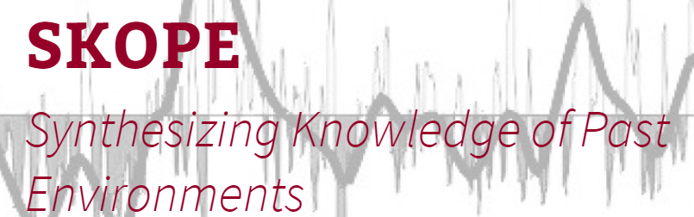
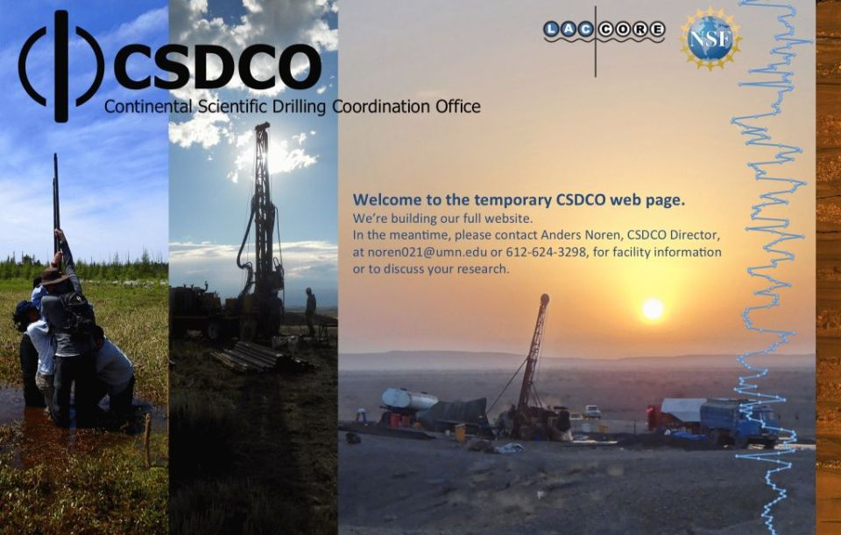




Next Level: Growing, Sustaining, and Connecting a Network of Networks
Biodiversity & Trait DBs
Paleoecology
Climate &
Paleoclimate
WaterIsotopes
Neotoma
ITRDB
Linked Earth
Ecology
PEcAn
Archaeology
Paleobiology DB
Sample & Core Curators
Geochronology
geochronAPI

Slide 13




Earth-Life Consortium & associated databases: connecting databases through APIs
Linking Fossil Occurrence DBs
Linking Fossil DBs
to Specimens
ELC APIs: Documentation & Sandbox
http://earthlifeconsortium.org/docs/api-docs.html
Linking traits to Specimens

Slide 14
Looking Ahead: Goals
Build Community
Encourage New Members, Users, Contributors, & Stewards
Expand Supported Regions & Data Types
Grow & Establish New Constituent Databases
Regions: Australia, Latin America, others?
Types
Organic biomarkers
Vertebrate isotopes
Ancient DNA
Development
DOIs for Datasets (beta version)
Embargo Manager
Link to Other Resources

Slide 15
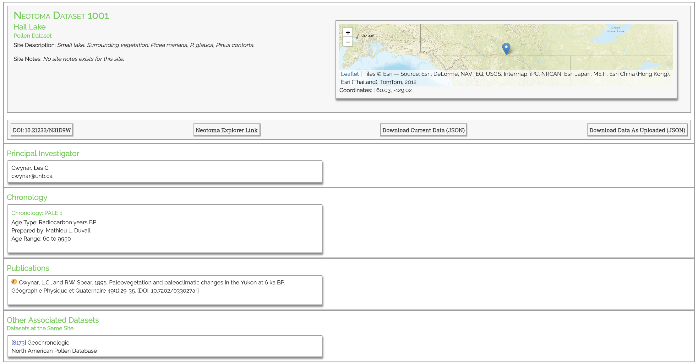
DOI Landing Pages
Example:
http://data-dev.neotomadb.org/1001

Slide 16
Neotoma Resources: Summary
Neotoma APIs
http://api.neotomadb.org/doc/
Neotoma Explorer
http://apps.neotomadb.org/explorer/
Walk-Through Teaching Exercise, Neotoma Explorer
http://serc.carleton.edu/neotoma/activities.html
neotoma (R package)
CRAN, Goring et al. 2015 Open Quaternary
ELC APIs
http://earthlifeconsortium.org/docs/api-docs.html
Flyover Country
https://flyovercountry.io/
Tilia
http://www.tiliait.com/download/

Slide 17
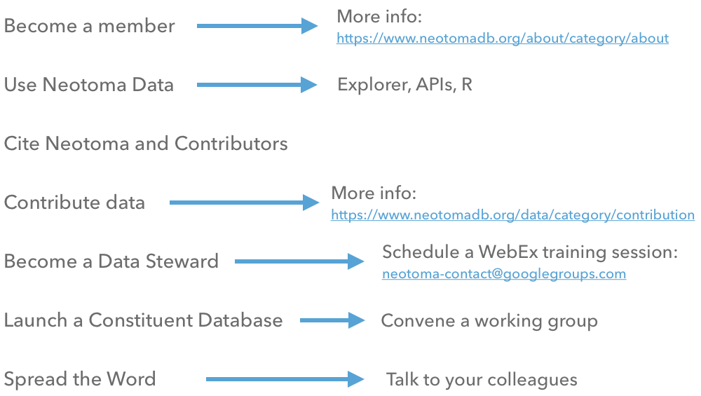
Join the Neotoma community!

Slide 19
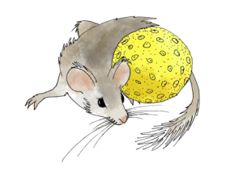
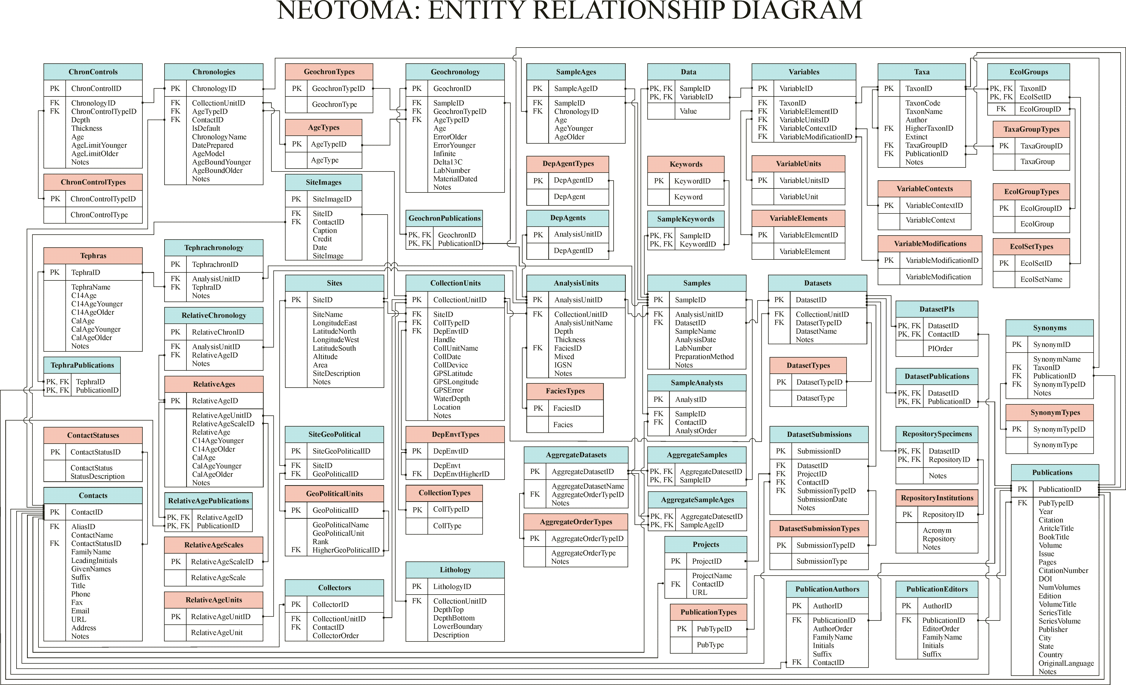
Navigating Neotoma: Key concepts and data model
Schema circa 2010:
Schema circa 2019:
More complicated now with additional functionality!
Best viewed at:
http://neotomadb.github.io/dbschema/index.html

Slide 20
Key Concepts: Sites, Collection Units, Analysis Units, Samples, Datasets
Sites
CollectionUnits
AnalysisUnits
Samples
Datasets
SiteID
SiteName
LongitudeEast
LatitudeNorth
LongitudeWest
LatitudeSouth
Altitude
Area
SiteDescription
Notes
CollectionUnitID
SiteID
CollTypeID
DepEnvtID
Handle
CollUnitName
CollDate
CollDevice
GPSLatitude
GPSLongitude
GPSError
WaterDepth
Location
Notes
AnalysisUnitID
CollectionUnitID
AnalysisUnitName
Depth
Thickness
FaciesID
Mixed
IGSN
Notes
SampleID
AnalysisUnitID
DatasetID
SampleName
AnalysisDate
LabNumber
PreparationMethod
Notes
DatasetID
CollectionUnitID
DatasetTypeID
DatasetName
Notes
One site may have many collection units
One collection unit may have many analysis units
One analysis unit may have many samples
A dataset comprises all samples of same type from same collection unit
*There is no set scale for these – user defined.
Notes:
Example:
La Brea Tar Pits is the site
The different pits (Pit 91, Project 23 Box 14) are different collection units
Within each pit, there’s often a grid set up, so the different grid cells are the analysis units

Slide 21
Key Concepts: Sites, Collection Units, Analysis Units, Samples, Datasets
La Brea
P23-Box14
A2/L2
Vertebrates
Sites
CollectionUnits
AnalysisUnits
Samples
Datasets
SiteID
SiteName
LongitudeEast
LatitudeNorth
LongitudeWest
LatitudeSouth
Altitude
Area
SiteDescription
Notes
CollectionUnitID
SiteID
CollTypeID
DepEnvtID
Handle
CollUnitName
CollDate
CollDevice
GPSLatitude
GPSLongitude
GPSError
WaterDepth
Location
Notes
AnalysisUnitID
CollectionUnitID
AnalysisUnitName
Depth
Thickness
FaciesID
Mixed
IGSN
Notes
SampleID
AnalysisUnitID
DatasetID
SampleName
AnalysisDate
LabNumber
PreparationMethod
Notes
DatasetID
CollectionUnitID
DatasetTypeID
DatasetName
Notes
One site may have many collection units
One collection unit may have many analysis units
One analysis unit may have many samples
A dataset comprises all samples of same type from same collection unit
*There is no set scale for these – user defined.
Notes:
Example:
La Brea Tar Pits is the site
The different pits (Pit 91, Project 23 Box 14) are different collection units
Within each pit, there’s often a grid set up, so the different grid cells are the analysis units

Slide 22
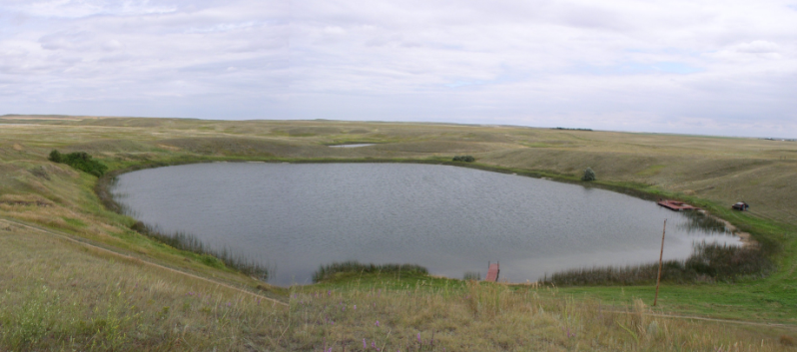
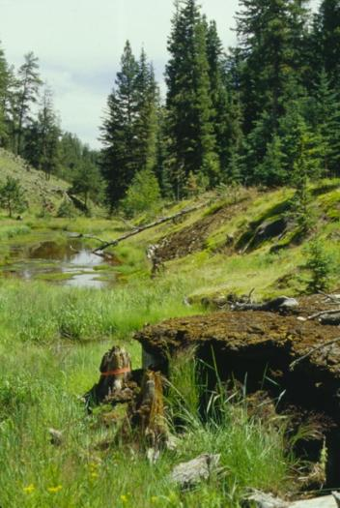
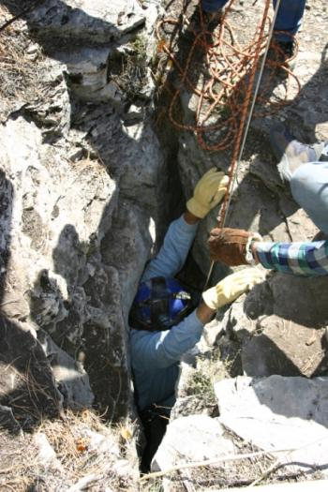
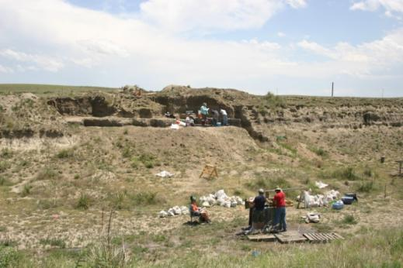
Sites
Sites Table
Lakes
Sections
Caves
SiteID
SiteName
LongitudeEast
LatitudeNorth
LongitudeWest
LatitudeSouth
Altitude
Area
SiteDescription
Notes
Archaeological Digs

Slide 23
Collection Units
Sites
CollectionUnits
Examples
Multiple cores w/in a lake
Multiple pits w/in an archaeological dig
Multiple bone piles within a cave
etc.
SiteID
SiteName
LongitudeEast
LatitudeNorth
LongitudeWest
LatitudeSouth
Altitude
Area
SiteDescription
Notes
CollectionUnitID
SiteID
CollTypeID
DepEnvtID
Handle
CollUnitName
CollDate
CollDevice
GPSLatitude
GPSLongitude
GPSError
WaterDepth
Location
Notes

Slide 24
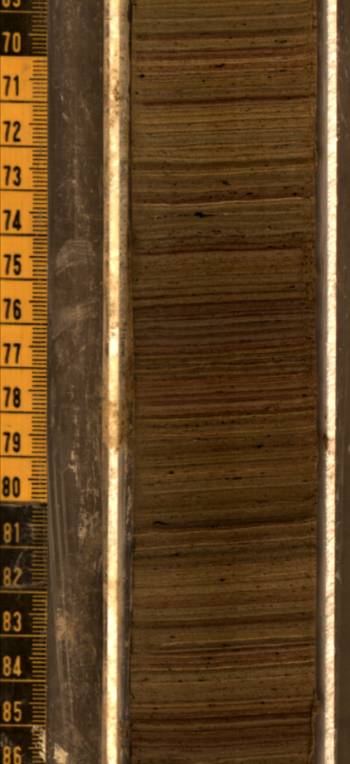
Analysis Units
CollectionUnits
AnalysisUnits
CollectionUnitID
SiteID
CollTypeID
DepEnvtID
Handle
CollUnitName
CollDate
CollDevice
GPSLatitude
GPSLongitude
GPSError
WaterDepth
Location
Notes
AnalysisUnitID
CollectionUnitID
AnalysisUnitName
Depth
Thickness
FaciesID
Mixed
IGSN
Notes
Analysis units may (or may not) have a depth and thickness, a location within an excavation grid, be named, etc.
Examples:
depths within a sediment core
strata within a cave deposit
grid cells within a pit

Slide 25
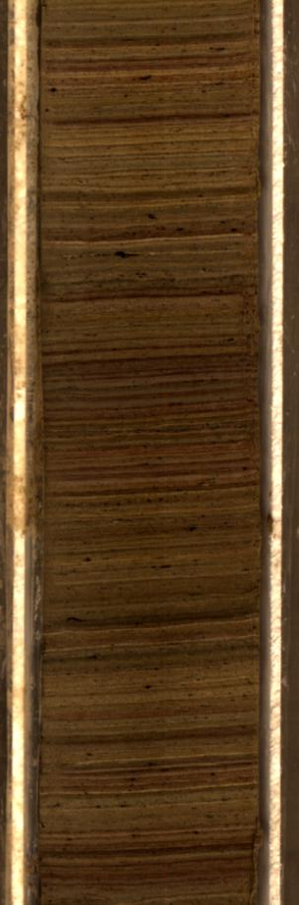
Samples
AnalysisUnits
Samples
Note: a collection of samples of the same data type is called a dataset
AnalysisUnitID
CollectionUnitID
AnalysisUnitName
Depth
Thickness
FaciesID
Mixed
IGSN
Notes
SampleID
AnalysisUnitID
DatasetID
SampleName
AnalysisDate
LabNumber
PreparationMethod
Notes
Plant macros
Mammals
Insects
Radiocarbon dates
Example: mammals, plant macrofossils, insects, radiocarbon dates from a single stratum within a deposit
Notes:
This is a level that makes more sense for pollen data, less for vertebrate data. But, we can envision a scenario where we have a stratum (analysis unit). The vertebrate bones within that stratum comprise the sample (so the analysis unit and sample are effectively the same). But…we also may reserve part of the sediments from the stratum for pollen analysis, or increasingly environmental DNA analysis, or perhaps to examine sedimentary isotopes. These would be different samples from the same analysis unit.

Slide 26
Extending Database Core to Specimens: Analysis Units, Samples, Data, Specimens
AnalysisUnits
Samples
Data
Specimens
AnalysisUnitID
CollectionUnitID
AnalysisUnitName
Depth
Thickness
FaciesID
Mixed
IGSN
Notes
SampleID
AnalysisUnitID
DatasetID
SampleName
AnalysisDate
LabNumber
PreparationMethod
Notes
DataID
SampleID
VariableID
Value
SpecimenID
DataID
ElementTypeID
SymmetryID
PortionID
MaturityID
SexID
DomesticStatusID
Preservative
NISP
RepositoryID
SpecimenNr
FieldNr
ArctosNr
Notes
One analysis unit may have multiple samples
One sample can be comprised of different data values
- Presence/Absence, NISP, MNI, % Abundance, etc
One sample may have multiple specimens
Notes:
Example:
La Brea Tar Pits is the site
The different pits (Pit 91, Project 23 Box 14) are different collection units
Within each pit, there’s often a grid set up, so the different grid cells are the analysis units

Slide 27
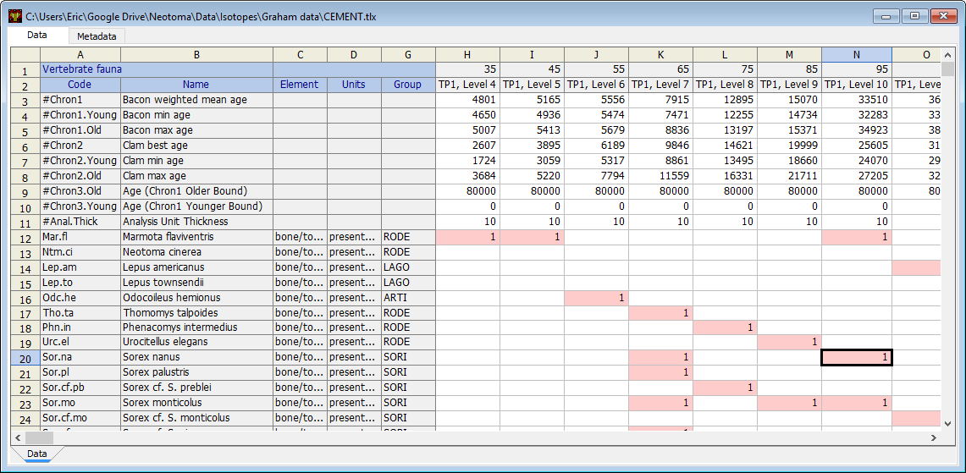
Specimens: examples with presence/absence
Assemblage Data Table

Slide 28
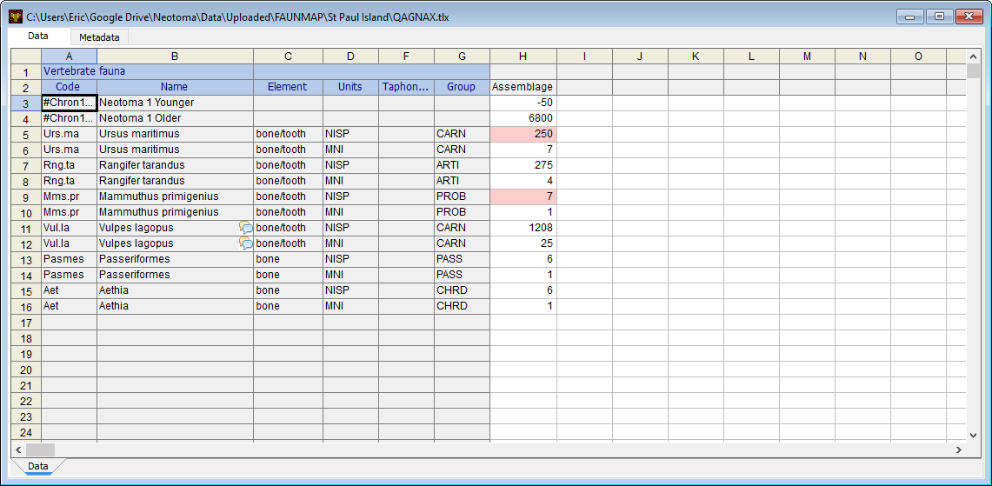
Specimens: example with NISP
Assemblage Data Table

Slide 29
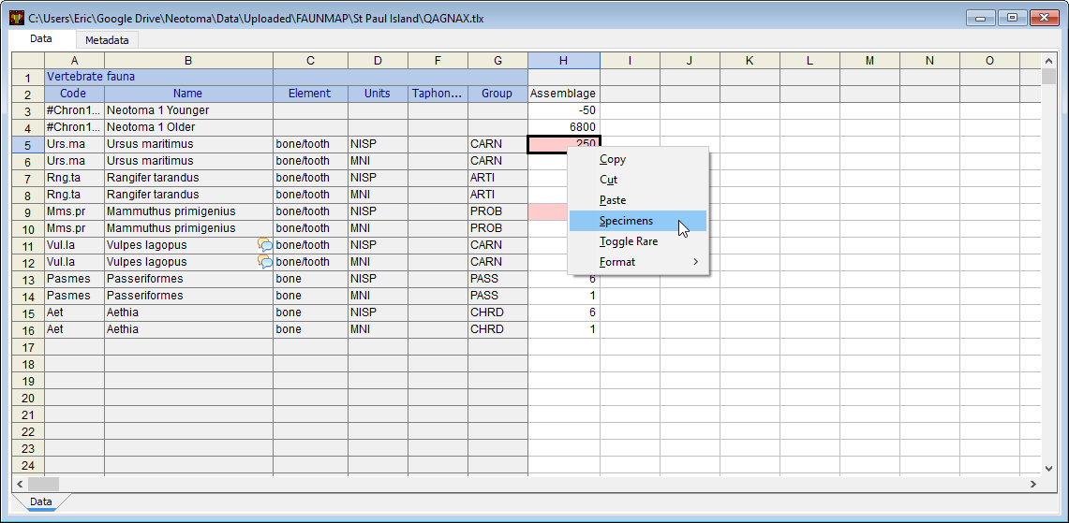
Specimens: example with NISP
Assemblage Data Table linked to specimens

Slide 30
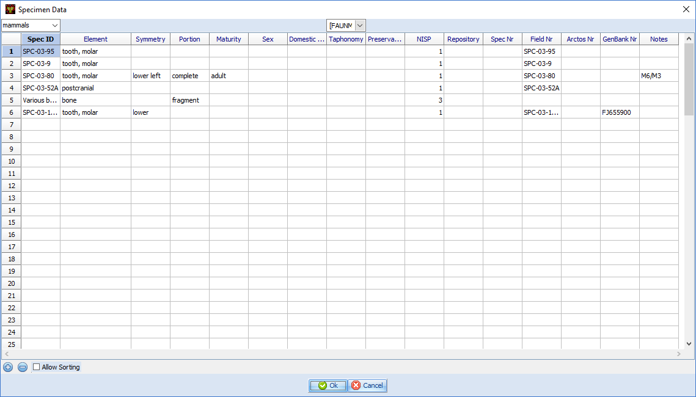
Specimens: examples
Specimen Data Table

Slide 31
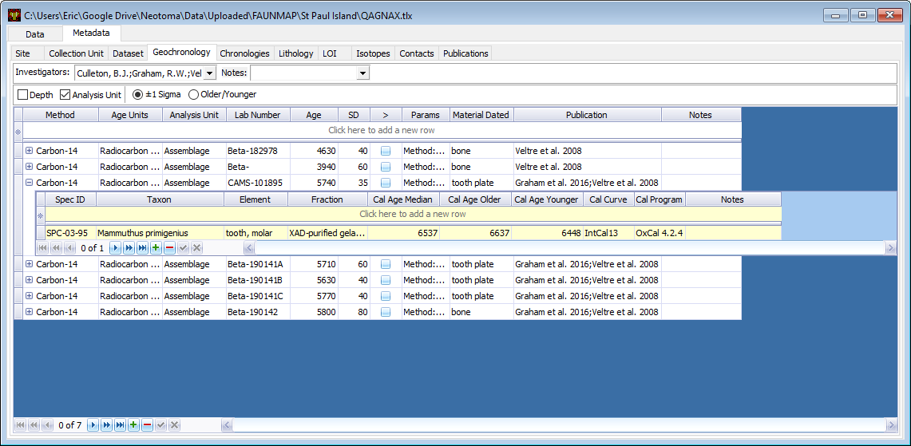
Specimens: also linked to radiocarbon dates

Slide 32
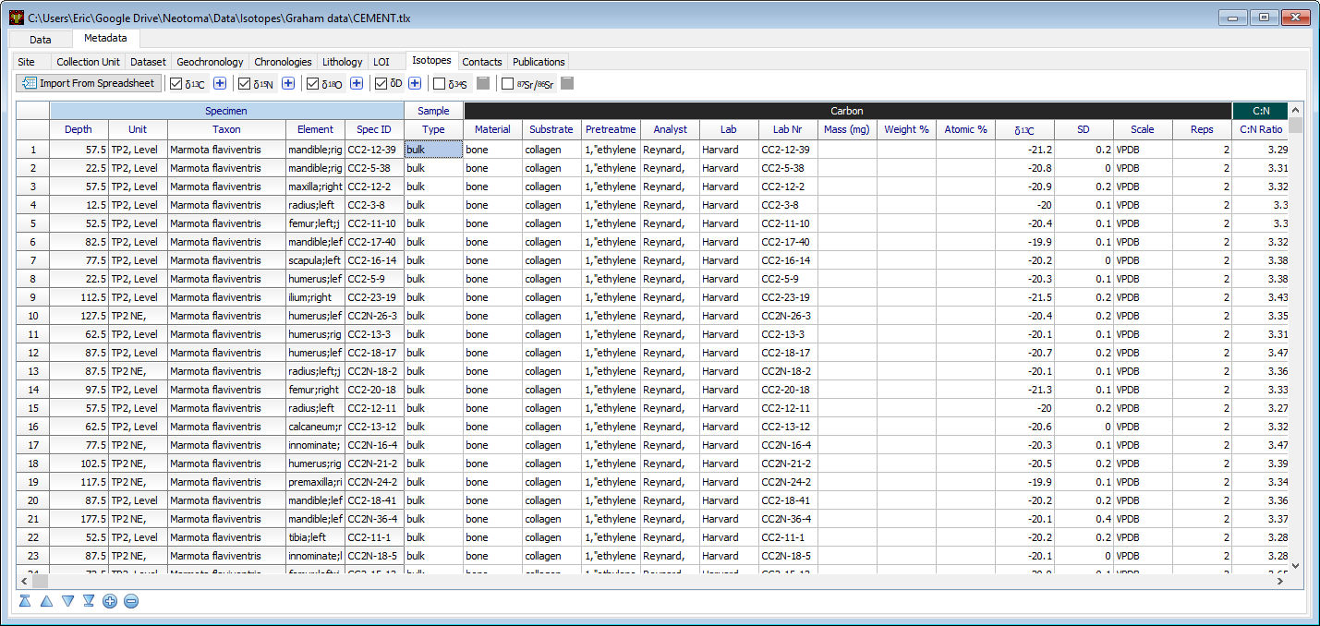
Specimens: linked to isotopes (C)

Slide 33
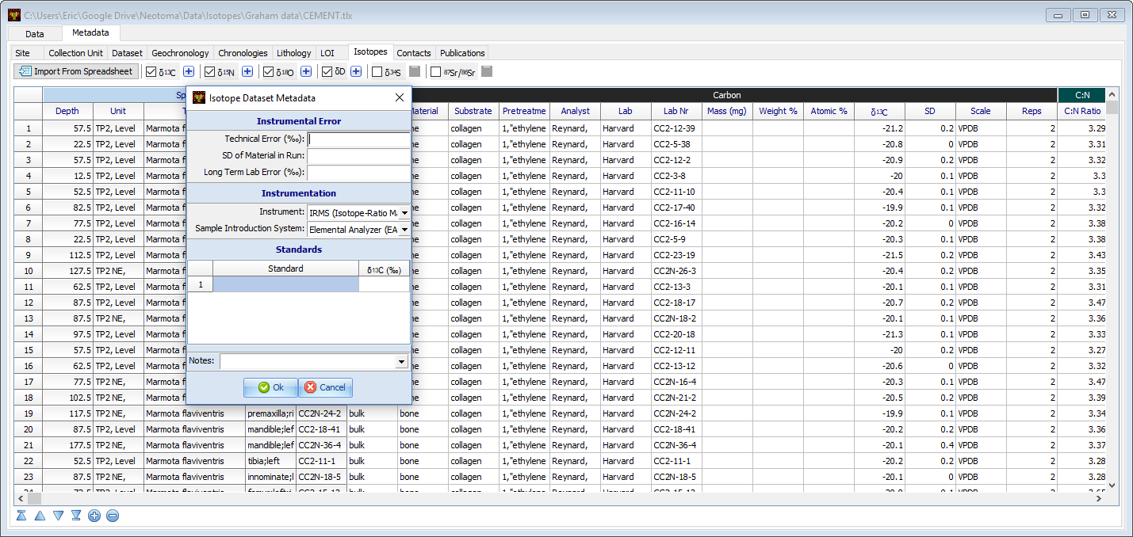
Specimen isotopes: rich metadata

Slide 34
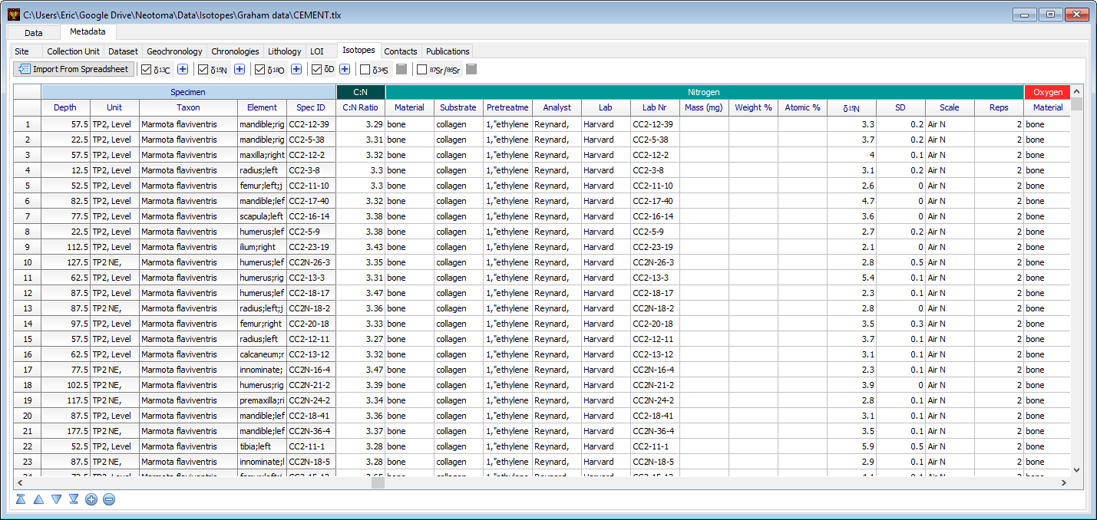
Specimens: linked to isotopes (N)

Slide 35
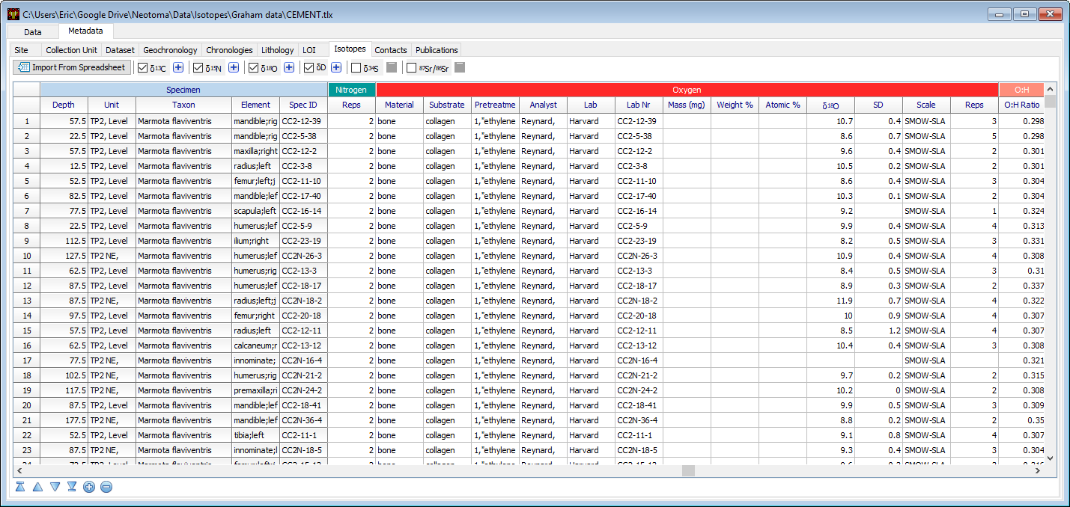
Specimens: linked to isotopes (O)

Slide 36
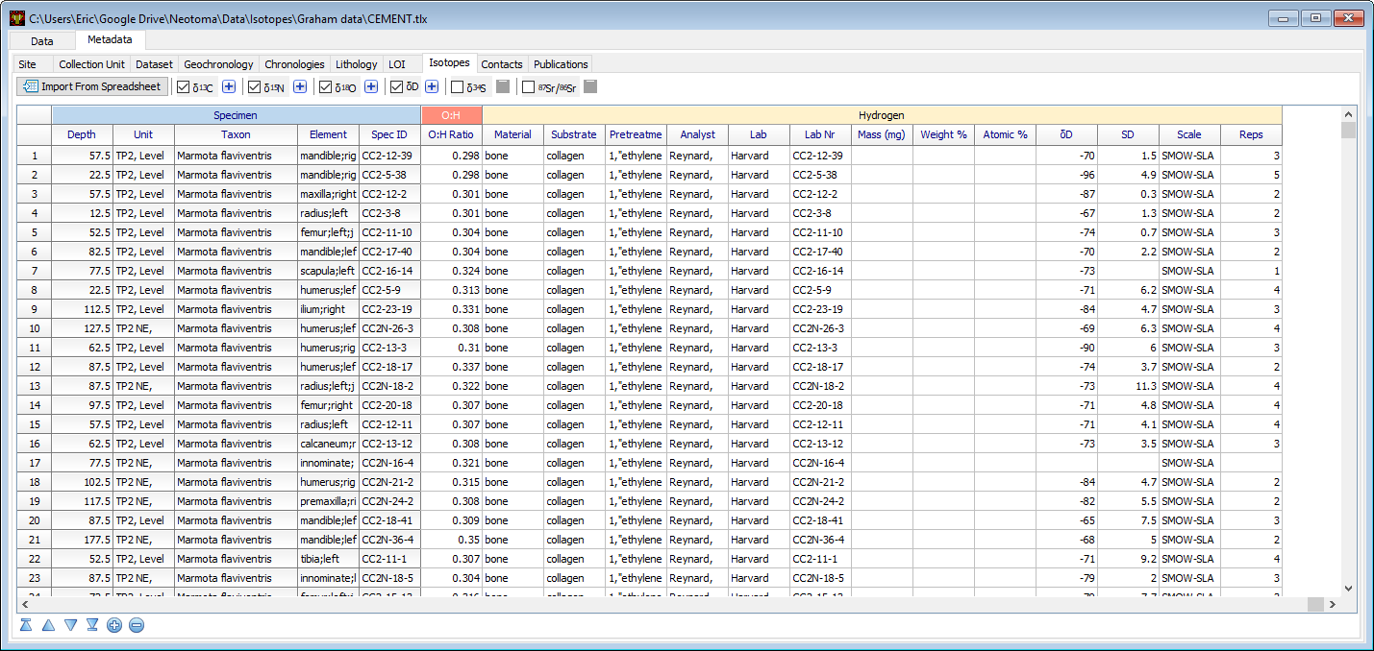
Specimens: linked to isotopes (H)

Slide 37
Time in Neotoma: Key Concepts
The Neotoma data model for time is based on three related concepts
Age Controls
Age-Depth Models
Chronologies
Age
Controls
Age-Depth Models
Chronologies

Slide 38
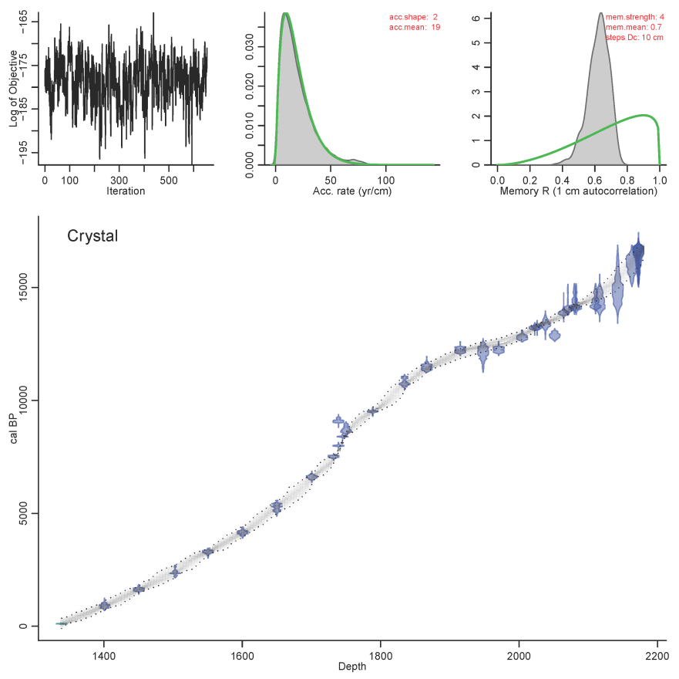
Time in Neotoma: Key Concepts
Age controls: an estimate of absolute age for a sample within a core or stratigraphic profile that is used to constrain an age model (e.g. radiocarbon dates)
Age-depth model: an algorithm used to estimate the age-depth relationship for a given stratigraphic profile.
Chronology: the series of estimated ages for a set of samples in a collection unit, linked to a particular combination of age controls and age-depth models

Slide 39
Geochronology
Geochronology
GeochronTypes
Amino acid racemization
Carbon-14
Cosmogenic
Electron spin resonance
Fission track
Potassium-argon
Optically stimulated luminescence
Lead-210
Silicon-32
Thermoluminescence
Uranium series
Carbon-14: accelerator mass spectrometry
Carbon-14: proportional gas counting
Carbon-14: liquid scintillation
Carbon-14: conventional radiometric
Argon-argon
Protactinium-231
Archaeomagnetic
Obsidian hydration
Paleomagnetic
Dendrochronological
GeochronID
SampleID
GeochronTypeID
AgeTypeID
Age
ErrorOlder
ErrorYounger
Infinite
Delta13C
LabNumber
MaterialDated
Notes
GeochronTypeID
GeochronType
*Note, you can now link to individual specimens within a dataset through the Samples table
**In Neotoma, Geochronology stores the radiometric age controls

Slide 40
Chronologies
CollectionUnits
Chronologies
ChronControls
CollectionUnitID
SiteID
CollTypeID
DepEnvtID
Handle
CollUnitName
CollDate
CollDevice
GPSLatitude
GPSLongitude
GPSError
WaterDepth
Location
Notes
ChronologyID
CollectionUnitID
AgeTypeID
ContactID
IsDefault
ChronologyName
DatePrepared
AgeModel
AgeBoundYounger
AgeBoundOlder
Notes
ChronControlID
ChronologyID
ChronControlTypeID
Depth
Thickness
Age
AgeLimitYounger
AgeLimitOlder
Notes
**In Neotoma, ChronControls stores the age controls used in an age model. Chronologies stores the age model metadata

Slide 41
Linking Geochronology with ChronControls
Geochronology
GeoChronControls
ChronControls
GeochronID
SampleID
GeochronTypeID
AgeTypeID
Age
ErrorOlder
ErrorYounger
Infinite
Delta13C
LabNumber
MaterialDated
Notes
ChronControlID
GeochronID
ChronControlID
ChronologyID
ChronControlTypeID
Depth
Thickness
Age
AgeLimitYounger
AgeLimitOlder
Notes

Slide 43
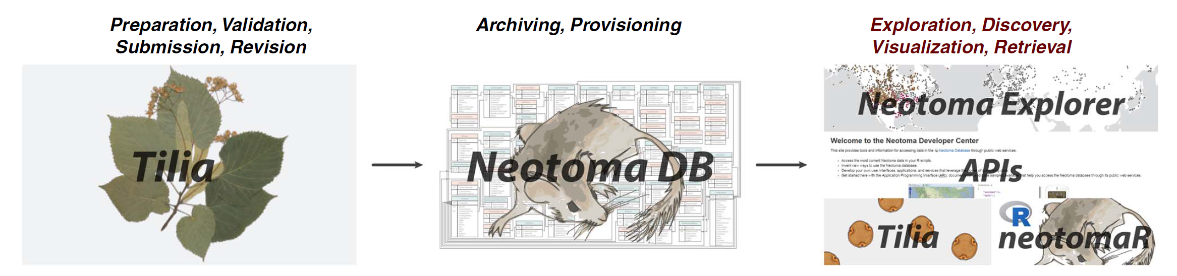
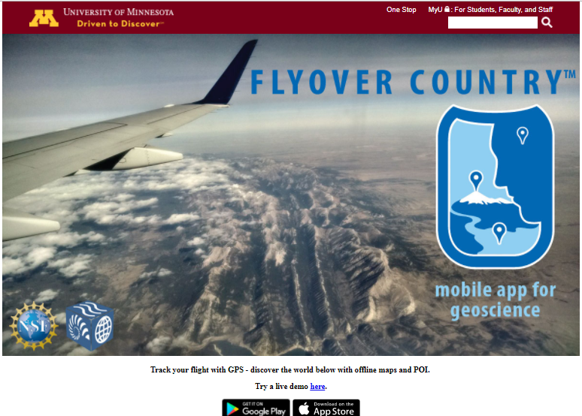
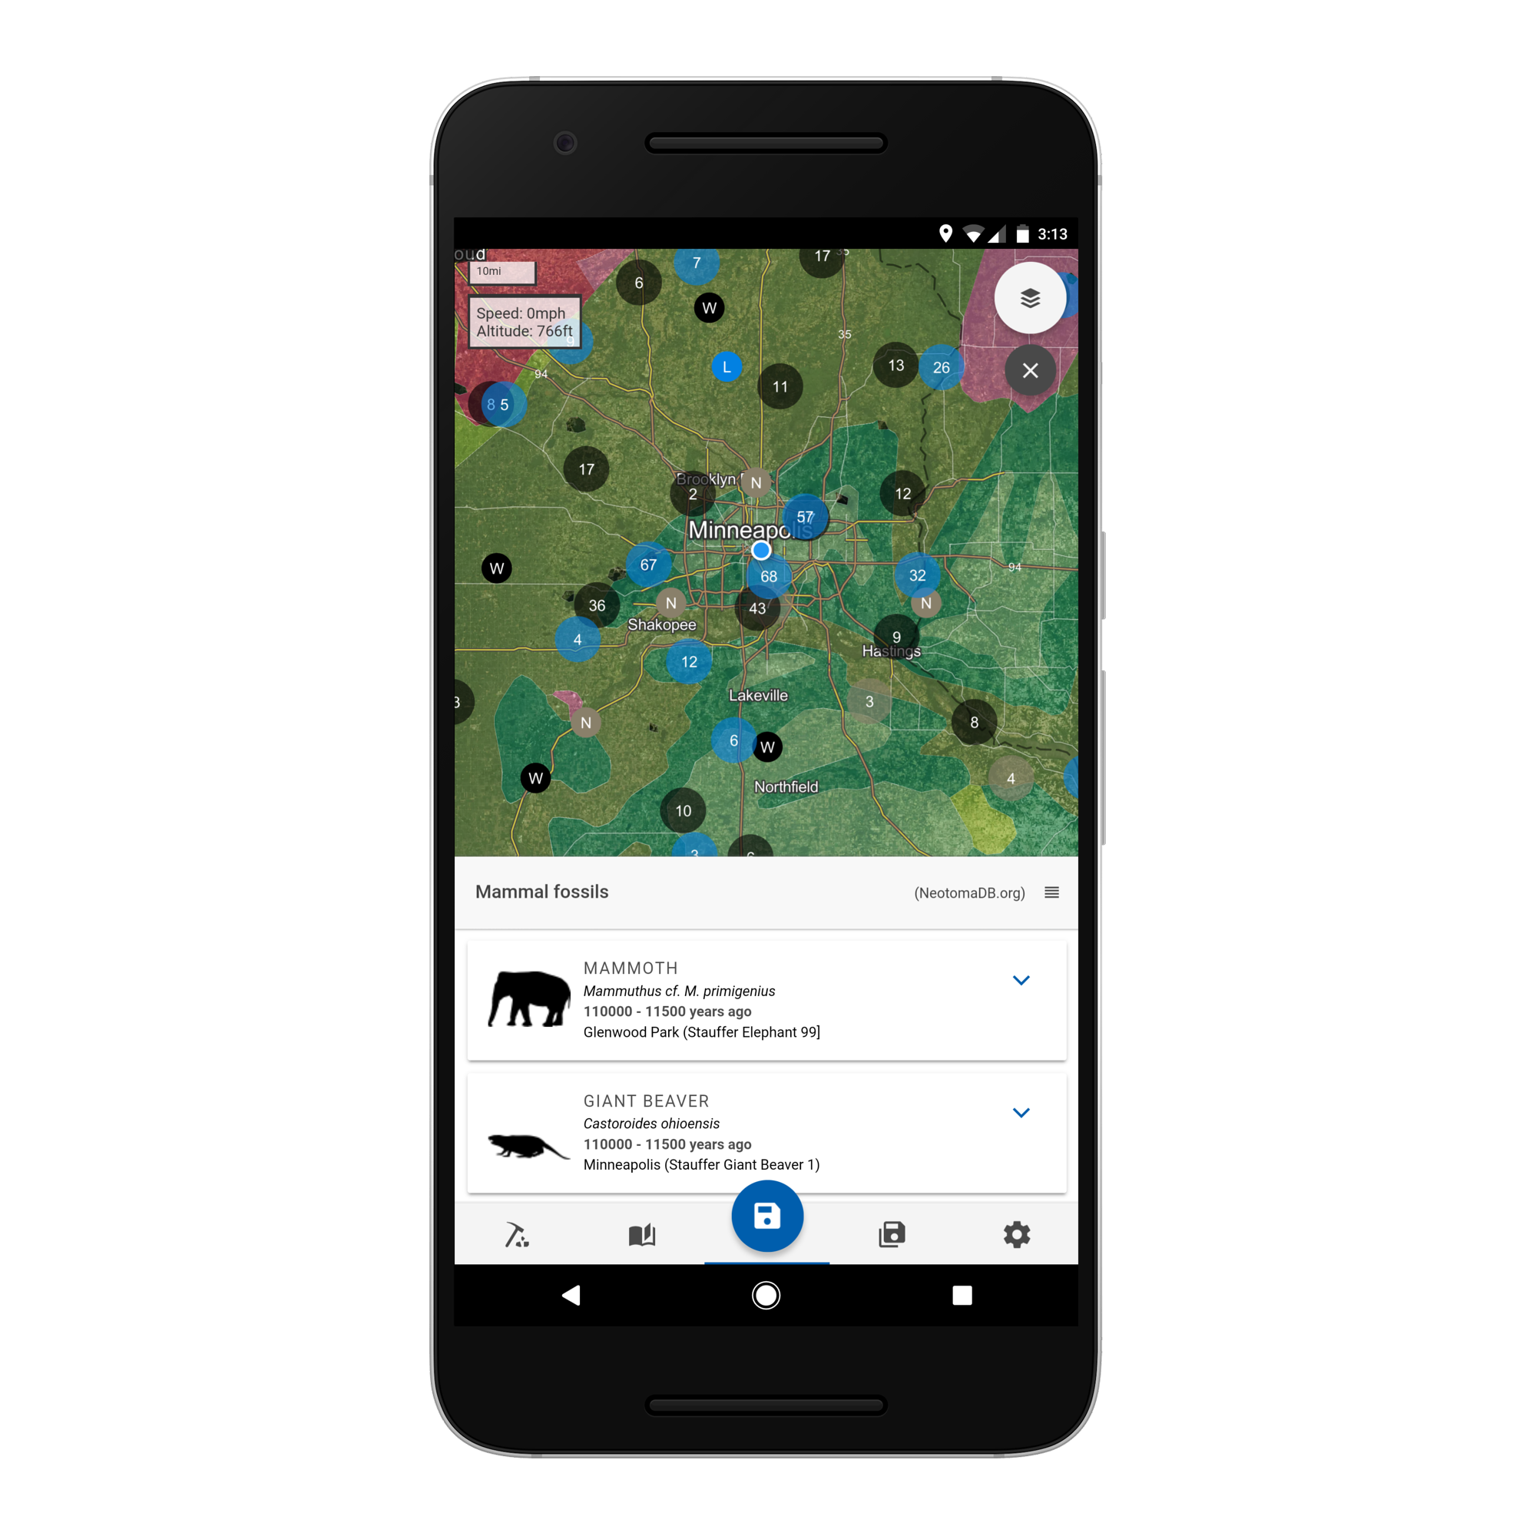
Neotoma Software Ecosystem: Getting data in and out of Neotoma
Third-Party Developers
Williams, Grimm, et al. 2018 QR

Slide 44
Getting started with contributing and using Neotoma data
Uploading data
Accessing data
Email your raw files to the vertebrate stewards.
Submit a Tilia file to the vertebrate stewards for validation and upload
Become trained as a steward yourself
Neotoma Explorer: https://apps.neotomadb.org/explorer/
Database snapshot: https://www.neotomadb.org/snapshots
Tilia
R (neotoma)
Notes:
Email the vertebrates steward with a file (ie, email Jessica Blois).
Back and forth about the file will ensue
works for simple data, single sites
not efficient or scalable
Can download Tilia and work on it on your own. Once the file is ready, email it to the vertebrate steward and it will be validated and uploaded
Become trained as a steward yourself, so that you can do the validation and uploading. Especially useful if you anticipate generating a lot of data or would like to become involved in improving the data.

Slide 45
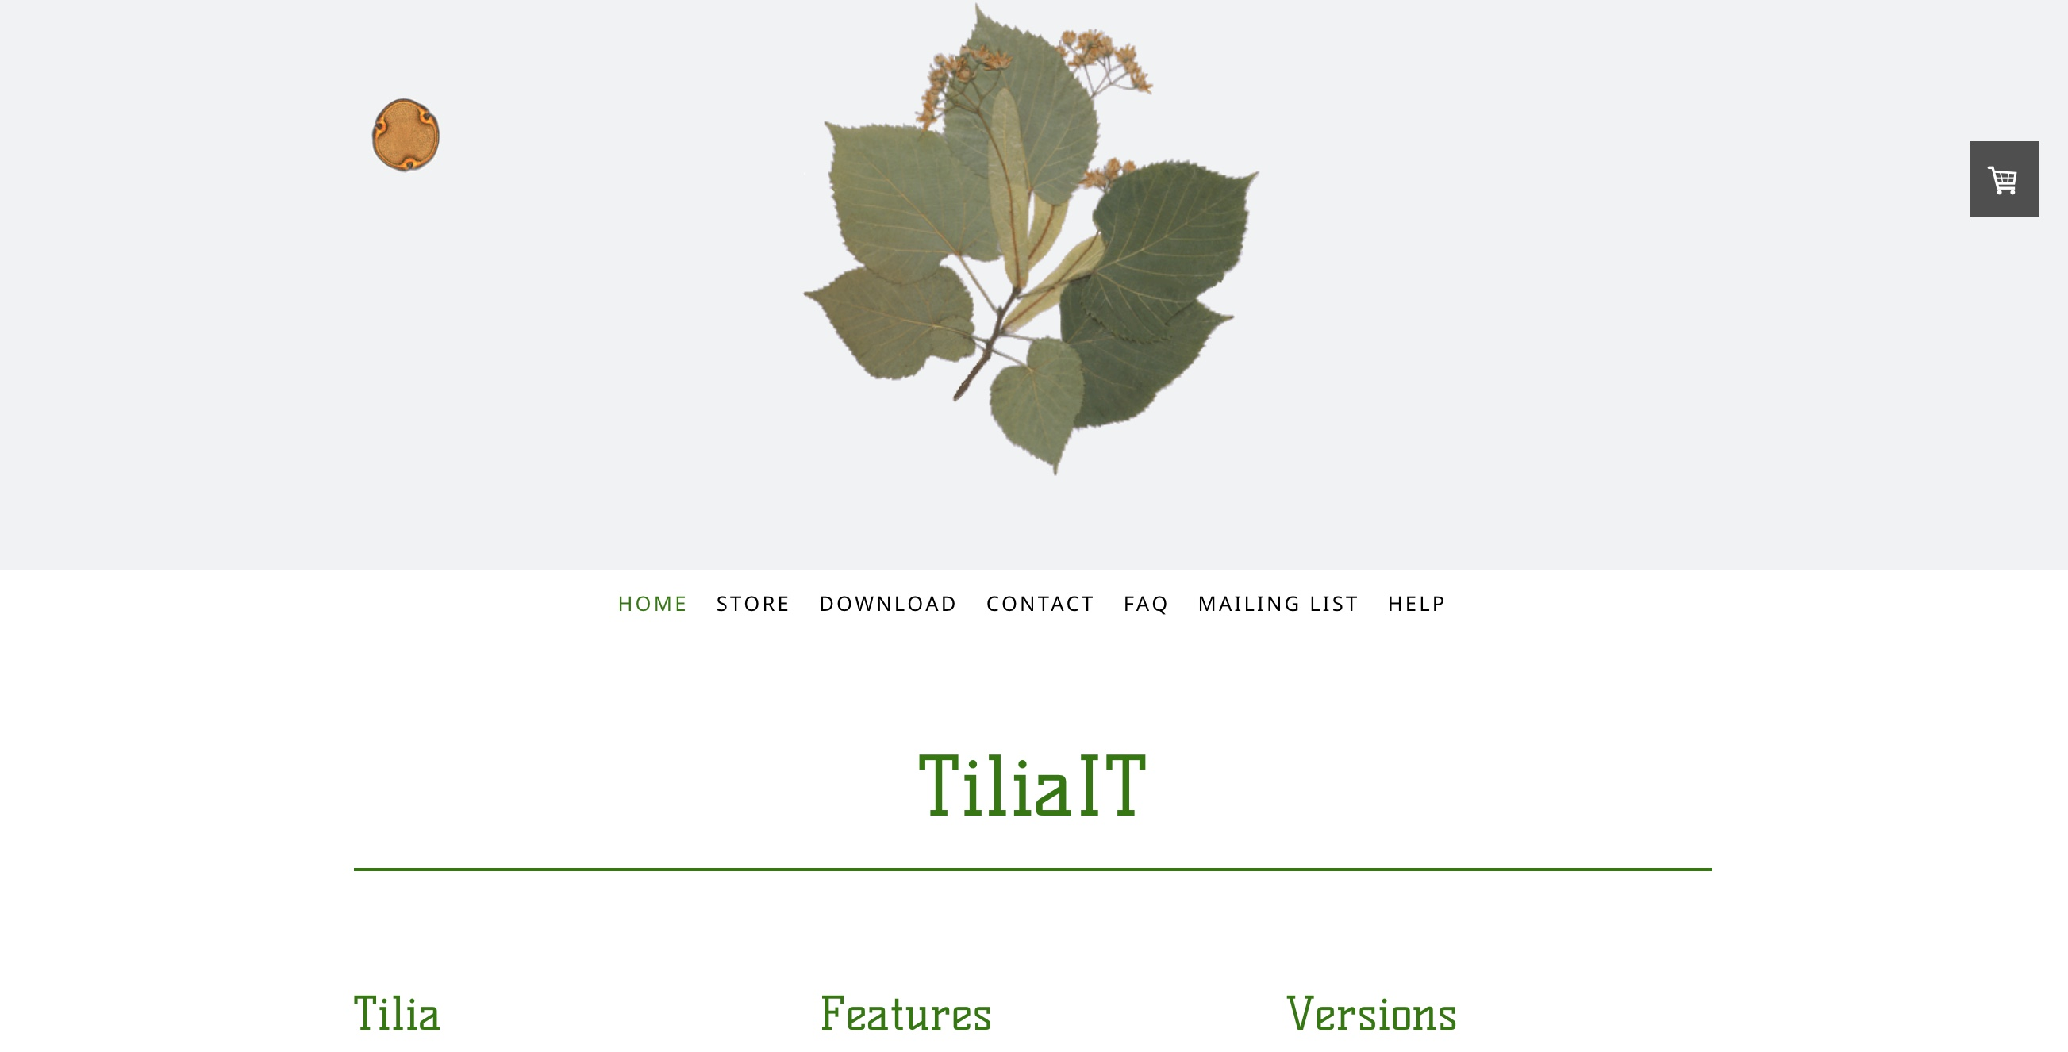
Tilia (Putting Data into Neotoma)
Free Download: http://www.tiliait.com/download/
Help resources: http://tilia-manual.readthedocs.org/
https://www.tiliait.com/help/

Slide 46
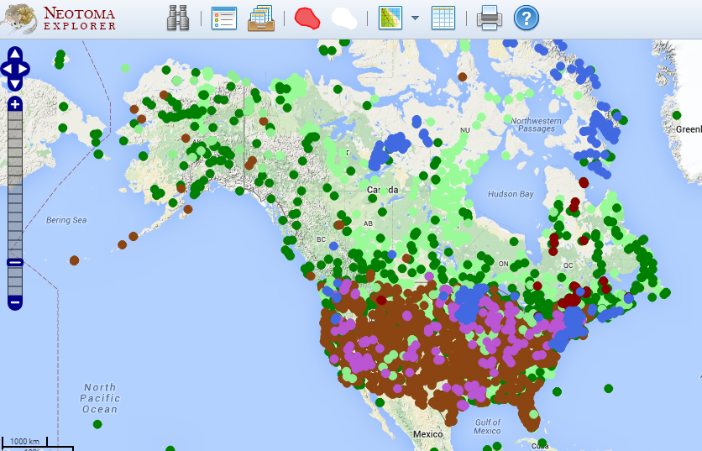
Neotoma Explorer (Finding/Exploring/Getting Data)
Teaching Exercise, Neotoma Explorer
http://serc.carleton.edu/neotoma/activities.html

Slide 47
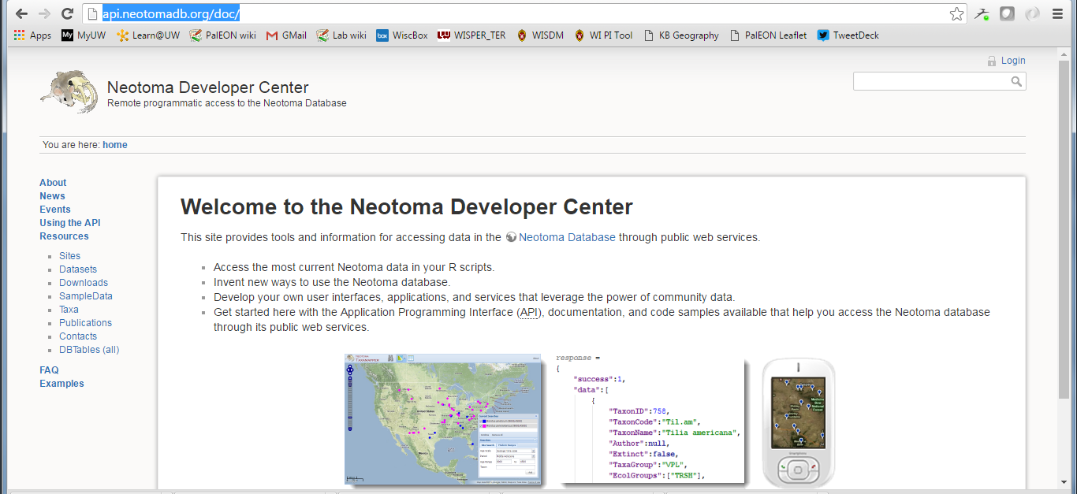
Neotoma APIs (Finding/Exploring/Getting Data)
APIs & Documentation available at:
http://api.neotomadb.org/doc/
Notes:
can build your own json queries, for example

Slide 48
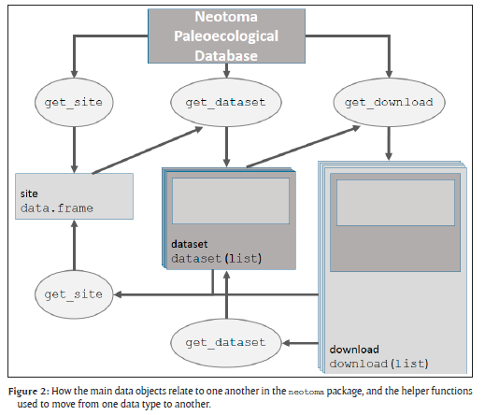
Neotoma R Porting Neotoma data to R environment
Key Functions
get_site
get_dataset
get_download
get_chroncontrol
get_table
get_taxa
Other Functions
get_closest
get_contact
get_publication
GitHub Repository: https://github.com/NeotomaDB/neotoma

Slide 49
Sandbox time!
Navigate to the Workshops directory and work through the tutorials:
https://github.com/NeotomaDB/Workshops/
Open the following link to get to the exercise:
http://open.neotomadb.org/Workshops/SVP2016/R/Workshop_SVP2016_v0.1.html

Slide 50
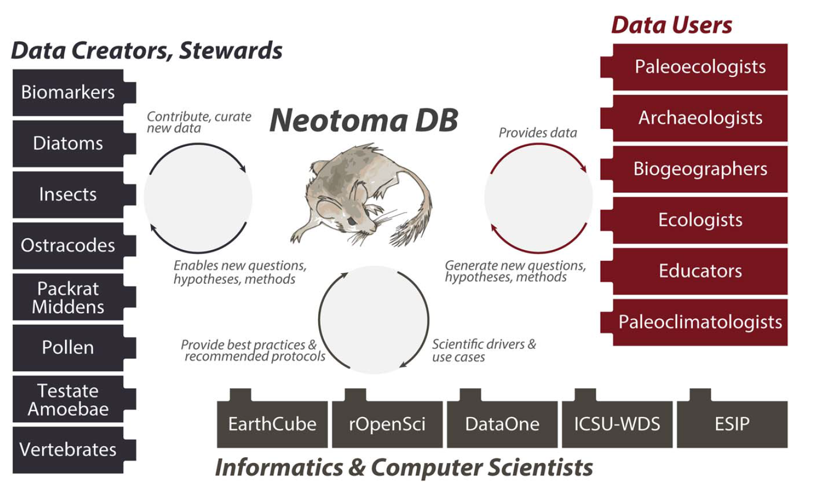
Neotoma as Boundary Organization

